Slide 1
Myrinet -- A Gigabit-per-Second Local-Area Network
Esha Desai
USC ID-6993245898

Slide 2
Myrinet Characteristics
New Local Area Network called the Myrinet based on technology used for packet communication and switching within “Massively-Parallel Processors”(MPPs).
Efforts to make the intra network speed as high as possible by Caltech Mosaic and USC ATOMIC
Used to interconnect clusters of workstations, PCs, servers, blade servers or single board computers.
Many similarities with the LAN such as any node can send data to any other node in form of packets.
Generally the packet consists of routing header to route through the network, which is followed by Payload and finally trailer is attached which is mainly checksum of the packet.
Myrinet has some distinct characteristics compared to LAN- such as High Data rates of around 1.28Gb/s with a duplex rate of 640Mb/s. The network is constructed by interconnecting elementary routing circuits in a regular mathematically regular topology like a 2-dimensional mesh network , unlike LAN in which packet traffic shares single physical medium.
Myrinet has Low error rate compared to LAN withCut-through routing .
Characteristic of Flow Control in which a packet is blocked only if an outgoing channel is already in use , by this the cut through routing does not require packet buffering , but each link must provide flow control.

Slide 3
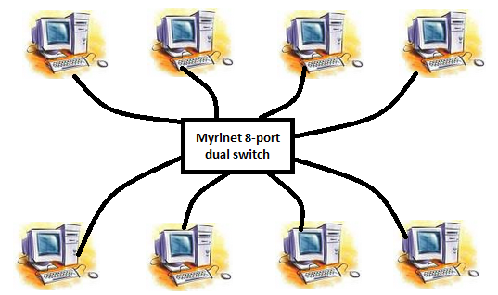
Myrinet switch comes in two forms 8-port and 4-port switch with its own 2 custom VLSI chips and network control software. The first one is the crossbar switch and the second one is the dual Myrinet interface chip which performs the flow control including two signals namely STOP and GO. It also has a slack buffer which helps in flow control. If the no. of packets are near the STOP line in the buffer then it sends the STOP signal to prevent buffer overflow and if near the GO line then it sends the GO signal to prevent data starvation.

Slide 4
Question
What were the steps taken for developing Myrinet?
Making robust 25m communication channels with the capability of error , flow control and packet framing.
Build host interfaces which can map the network , which can select routes and also translate from network addresses to routes and handle packet traffic too.
Cut through switches with the capability of self initialization and low latency.
Required development of streamlined host software which allowed direct communication between the network and user processes.

